Slide 1
Spiking Neural Networks with Predictive Feedback
Timur Ibrayev

Slide 2
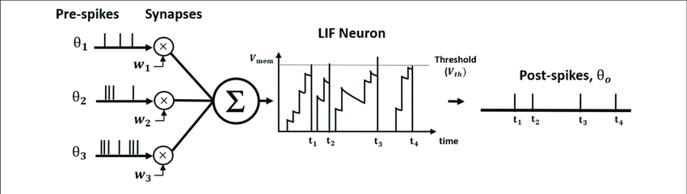
Introduction
Spiking Neural Networks – inspired by the experimental evidence of brain using spikes to communicate between neurons
Motivation: computational efficiency
Mechanisms:
Neuro-inspired neuron models (e.g. leaky-integrate-and-fire)
Binary feature maps
Replacement of MAC (multiply and accumulate) to AC (accumulate)

Slide 3
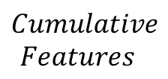



Idea
Current SNNs
Poisson Spike Gen
$$Cumulative$$
$$Features$$
Input
x
Feedforward SNN
(time steps = T)
Classifier
$$μ$$
$$s$$
$$input_{spikes}=s=U\left(0,1\right)≤μ$$

Slide 4





Idea
Current SNNs
Poisson Spike Gen
$$Cumulative$$
$$Features$$
Input
x
Feedforward SNN
(time steps = T)
Classifier
$$μ$$
$$s$$
$$input_{spikes}=s=U\left(0,1\right)≤μ$$
Proposed SNN with Feedback
Poisson Spike Gen
$$Forward Features_{1}$$
Input
x
Feedforward SNN
$$μ$$
$$s$$
for a total of T timesteps
$$Backward Features_{1}$$
Feedback SNN
$$p_{1}$$

Slide 5
Target objectives
To increase activation sparsity:
Can be achieved by “blocking” input neurons that are predicted within some epsilon ε bound
To adaptively determine required timesteps T per input sample:
Can be achieved by early stopping inference on samples for which all input neurons are predicted
Implicit attention through contrast:
If (1) works, then after each timestep renormalize the input after “blocking” predicted neurons

Slide 6
Procedure
Train baseline feedforward only networks:
Train FF ANN
Train FF SNN
Write the model with feedback path for ANN
Train ANN with feedback:
Single timestep or multistep? -> single timestep
How good the reconstruction is? -> good enough
Write the model with feedback path for SNN
Train SNN with feedback:
Define training loss? -> standard ff training for cls + reconstruction (mse) loss based on cumulative fb features at the last timestep only
What should be the trade_off between cls and reconstruction loss?
Post hoc analysis
Qualitative assessment of predictions
Can predictions be used to achieve target objectives?

Slide 7
Results
Predictions produced by feedback path at each timestep
Input neurons “blocked” by predictions,
if prediction is within ε=0.1 bound of actual input value
at each timestep

Slide 8
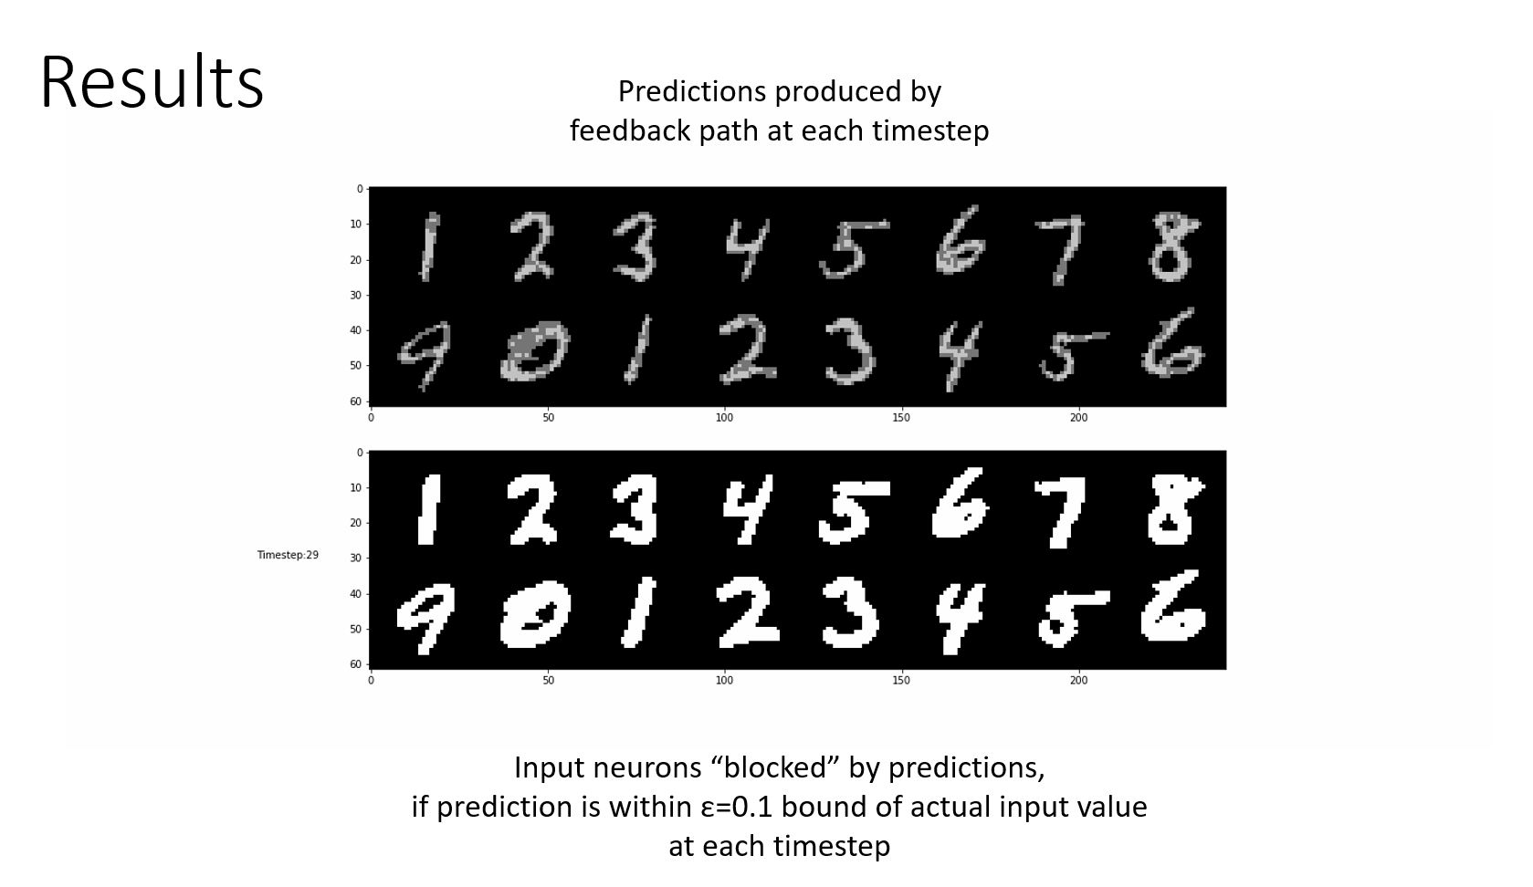

Slide 9
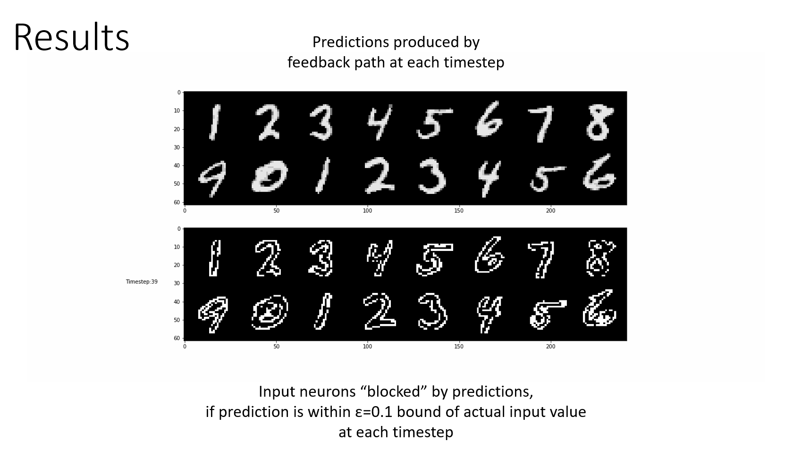

Slide 10
Results
 | ANN | SNN |  | SNN with Input Blocking
 | Accuracy | Accuracy | # of spikes | Accuracy | # of spikes
VGG6 | 99.43 | 99.42 | ~116808 | - | -
VGG6_wFeedback | 99.18 | 99.14 | ~388038 | 99.05 | ~360811

